Slide 1
MAJOR PROJECT ON OBSTACLE AVOIDING ROBOT
Made By:-
Aadarsh Kumar Singh
Parth Dohan
Saksham Bhandari
Vatsalya Singh Baghel

Slide 2
INTRODUCTION:
An obstacle avoiding robot is an intelligent device, which can automatically sense and overcome obstacles on its path. Obstacle Avoidance is a robotic discipline with the objective of moving vehicles on the basis of the sensorial information. The use of these methods front to classic methods is a natural alternative when the scenario is dynamic with an unpredictable behaviour. In these cases, the surroundings do not remain invariable, and thus the sensory information is used to detect the changes consequently adapting moving. It will automatically scan the surrounding for further path.

Slide 3
EXISTING SYSTEM
A simple robot, steering algorithm is used for robotic actions in which driver or a human being is controlling the robot using remote. Here driver is present, who can see the obstacle and navigate robot accordingly.

Slide 4
PROPOSED SYSTEM:
The project proposes an autonomous robotic vehicle, in which no remote is used for controlling the robotic actions. It intelligently detects obstacles present on its path through the sensors, avoid it and take decision on the basis of internal code that I set for it.

Slide 5
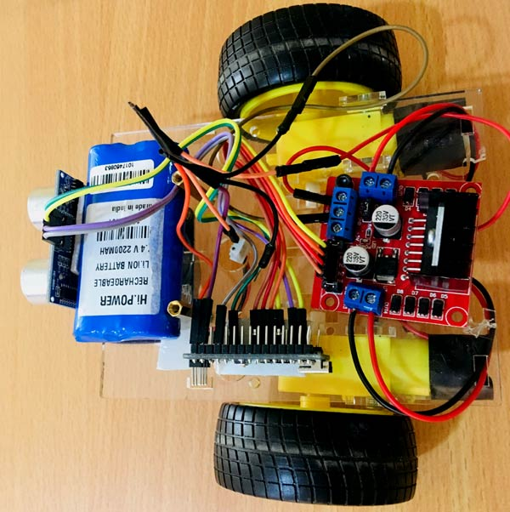
WORKS ON PROJECT: DESIGN ROBOT:
Obstacle Avoiding Robot is an intelligent device which can automatically sense the obstacle in front of it and avoid them by turning itself in another direction. Design of the Obstacle Avoiding Robot:

Slide 6
HARDWARE CONFIGURATION:
Arduino Uno
Ultrasonic Range Sensor – HC – SR04
Motor Driver IC – L293D
DC Motors x 2
Power Batteries
Jumper Wires
Wheel Chassis

Slide 7
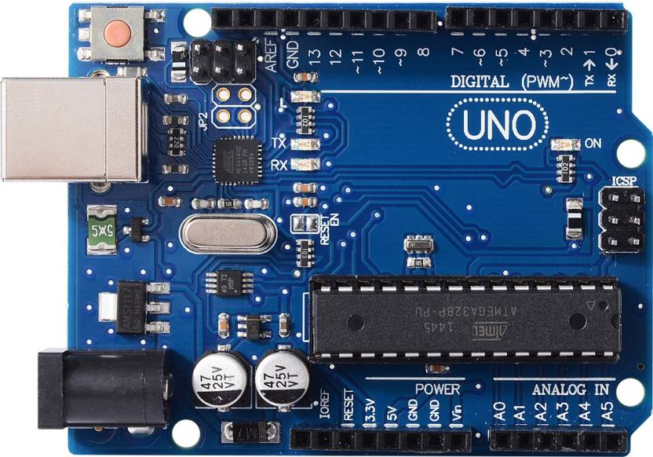
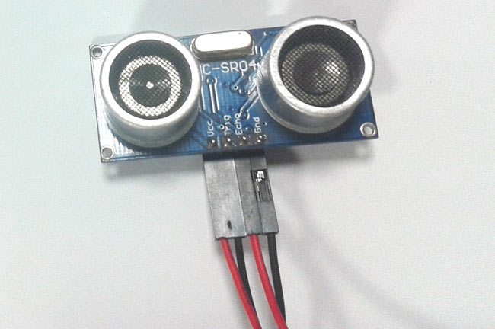
1.ArduinoUno: The Arduino Uno is an open source microcontroller board based on the Microchip ATmega328P microcontroller and developed by Arduino. The board is equipped with sets of digital and analog input/output pins that may be interfaced to various expansion boards and other circuits.
2. Ultrasonic sensor:
Ultrasonic sensor are devices that use electrical–mechanical energy transformation to measure distance from the sensor to the target object. Ultrasonic waves are longitudinal mechanical waves which travel as a sequence of compressions and rarefactions along the direction of wave propagation through the medium.

Slide 8
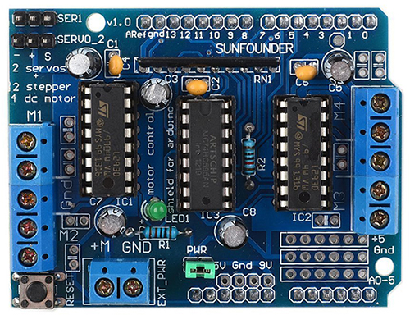
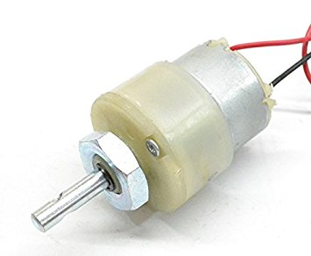
3. Motor Driver IC – L293D: Arduino board is connected with DC Motor through Motor driver board(pin10, pin11, pin12, pin13)which provide power to the actuators. Actuators are used to move robot in Forward, Backward, Left and Right directions.
4. DC Motors x 2 :
DC motors normally have just two leads, one positive and one negative. If you connect these two leads directly to a battery, the motor will rotate. If you switch the leads, the motor will rotate in the opposite direction.

Slide 9

SOFTWARE SPECIFICATION:
Arduino is an open-source electronics platform based on easy-to-use hardware and software. Arduino boards are able to read inputs - light on a sensor, a finger on a button, or a Twitter message - and turn it into an output - activating a motor, turning on an LED, publishing something online. You can tell your board what to do by sending a set of instructions to the microcontroller on the board. To do so you use the Arduino programming language, and the Arduino Software IDE based on processing.

Slide 10
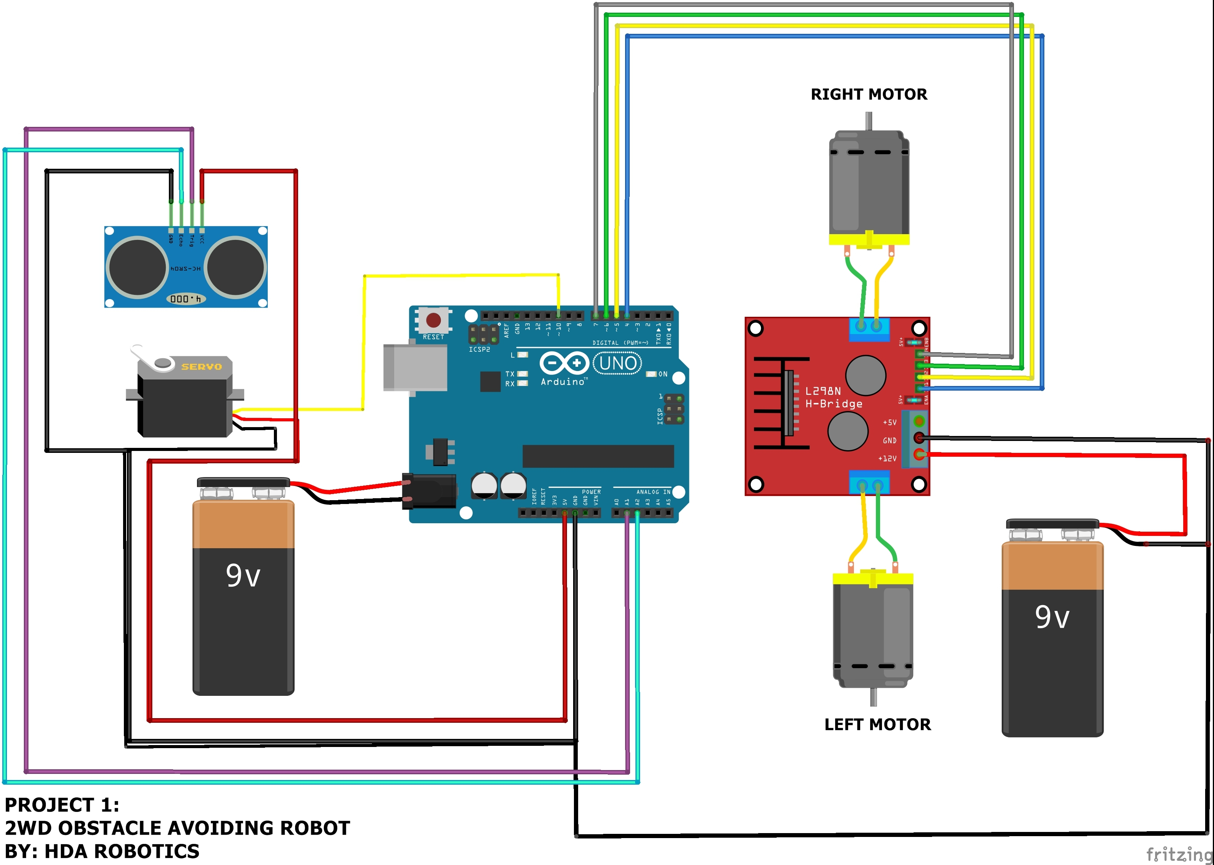
CIRCUIT DIAGRAM:

Slide 11
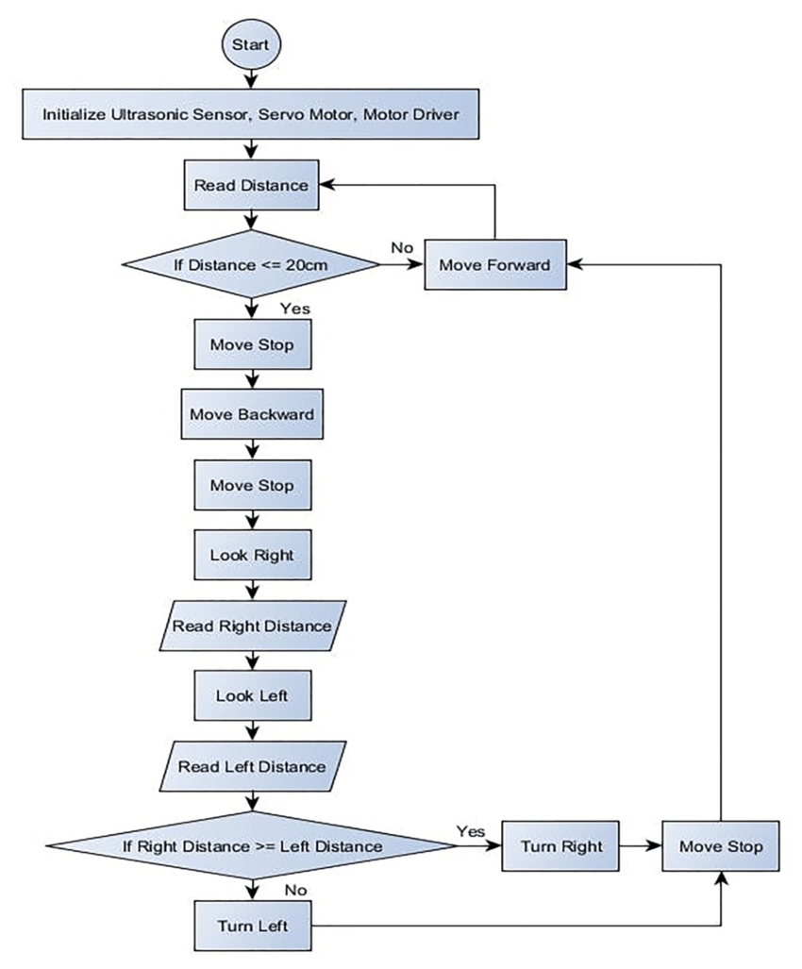
FLOWCHAT PROCESS:

Slide 12
CONCLUSION:
The goal of our project is to create an autonomous robot which intelligently detects the obstacle in its path and navigate according to the actions that I set for it.
This project developed an obstacle avoiding robot to detect and avoid obstacles in its path. The robot is built on the Arduino platform for data processing and its software counterpart helped to communicate with the robot to send parameters for guiding movement. For obstacle detection, three ultrasonic distance sensors were used that provided a wider field of detection. The robot is fully autonomous and after the initial loading of the code, it requires no user intervention during its operation. When placed in unknown environment with obstacles, it moved while avoiding all obstacles with considerable accuracy.

